Slide 2
Getting Started with Office 365
Ashok Kumar Jayabalan

Slide 3
Agenda
What is Office 365
Where’s it hosted?
How to setup Office 365
Identity and Authentication
Which Office 365 Plan…
User Management
Gotchas

Slide 4
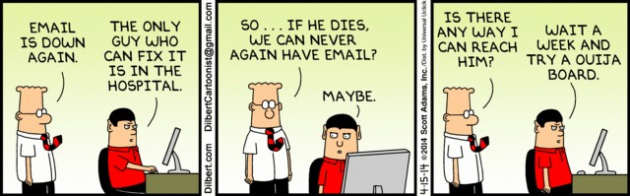
Why Cloud?

Slide 5





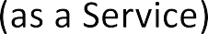
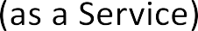






Cloud Computing
Cloud Computing

Slide 6




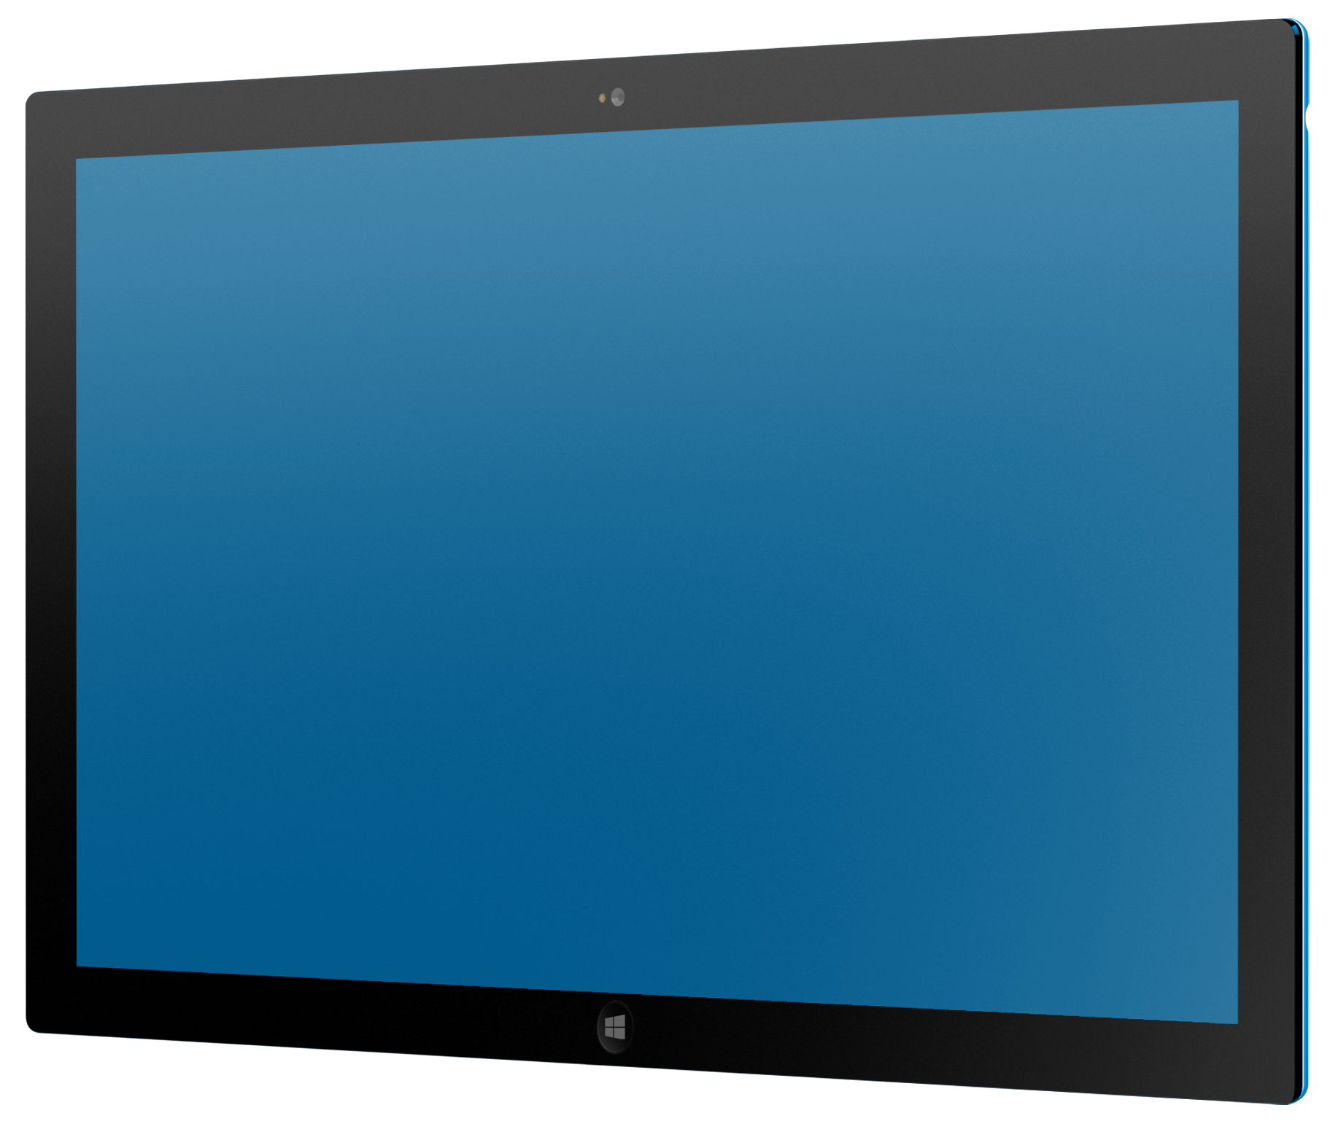

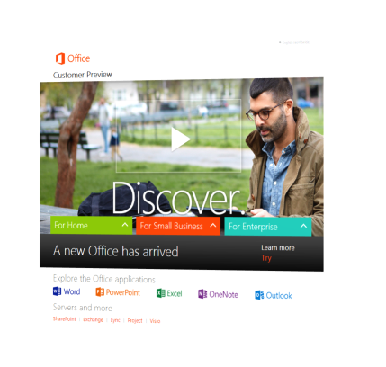












Office 365 | What is it?
Latest productivity services running in Microsoft’s cloud

Slide 7
What is Office 365?
Office 365 is…
the successor to Microsoft's Business Online Productivity Suite
a subscription-based service which offers access to various services and software built around the Microsoft Office platform.
Can be free for 501(c)3 non-profits and accredited educational institutions or super low cost depending on subscription.
low cost for everyone else.
accessible anywhere you have a device and an internet connection, is secure, and meets many compliance standards like FedRamp, FISMA, HIPAA, etc.
Subscription are per user/month, can be mixed and matched, and there is no minimum number of users.

Slide 8
What do you get with Office 365?
The main Office 365 offering includes:
Exchange Online– Enterprise-grade email and shared calendars. 50 GB mailbox per user. Unlimited archiving available depending on subscription.
Skype for Business Online– Presence plus online webconferencing (screen sharing, HD video, audio). Similar to WebEx and GoToMeeting.
OneDrive for Business – Similar to Dropbox or Box. 1TB space per user.
SharePoint Online– Collaborate with teammates, partners, and customers with documents that are always up to date and accessible from almost anywhere.
Website - Market your business with a website that's easy to set up and update—with no hosting fees. SharePoint 2013 is behind it as well. Only for accounts prior to 31 Jan 2015.
Office Web Apps - Create, store, edit, and share Word, PowerPoint, Excel, and OneNote docs online.
Microsoft Office Professional Plus desktop applications (current and previous) on certain plans. For Mac and PC. Also, works on Apple, Android, and Windows devices.
Other features depending on subscription – Legal hold, eDiscovery, self-serve BI, extended SharePoint features
Each of these and more are available as a standalone subscription.

Slide 10












Why Office 365?
Fast and fluid experience with touch, pen, mouse & keyboard
Immersive touch-optimized Windows 8/8.1/10 apps
Support for Windows phone, iOS and Android phones
Office – on the web, desktop and mobile
Open development model
Enterprise-grade reliability and standards
Modern Authentication
Newsfeeds and microblogging, extend with Yammer
Pervasive social capabilities across Office
Multiparty HD video & Skype federation
DLP, data retention & unified eDiscovery
Reimagined deployment model for Office apps with Click to Run and Mobility
Common management experience across Office 365

Slide 11
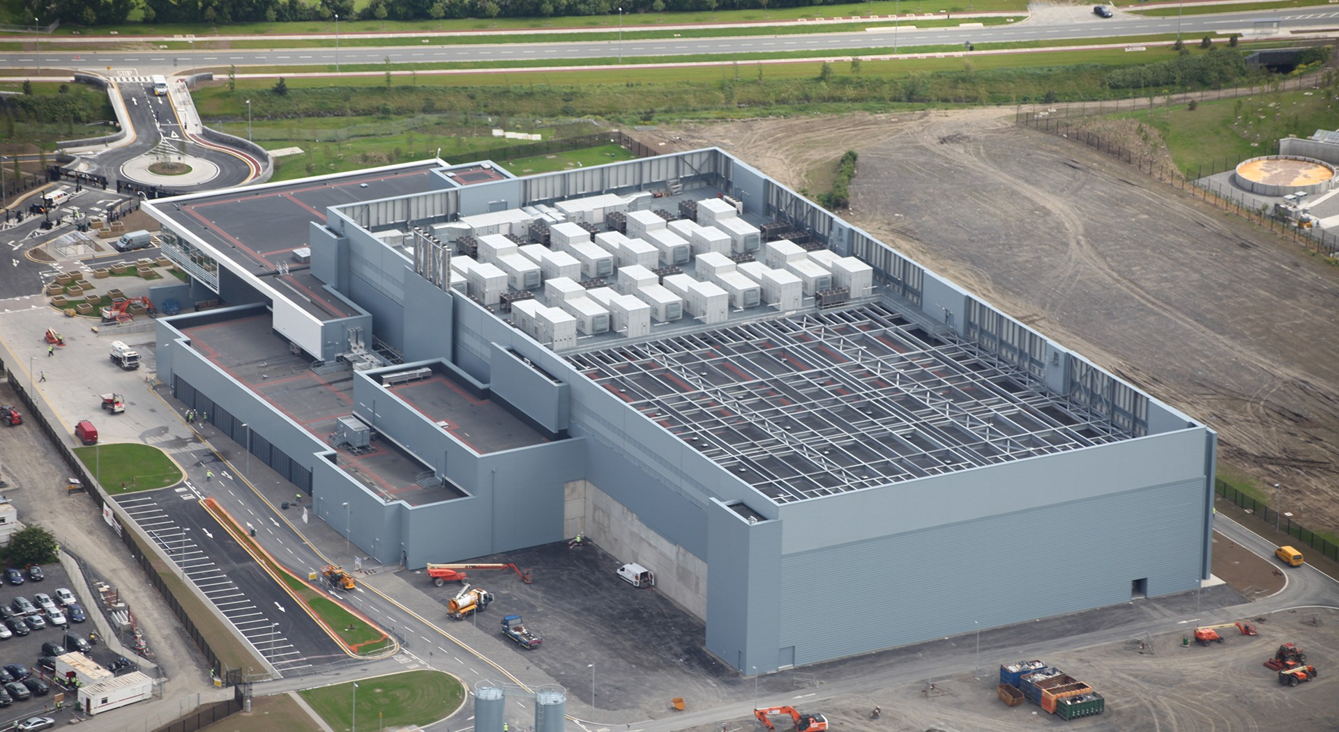
Where’s it hosted?
htt
p://www.extremetech.com/extreme/161772-microsoft-now-has-one-million-servers-less-than-google-but-more-than-amazon-says-ballmer

Slide 12
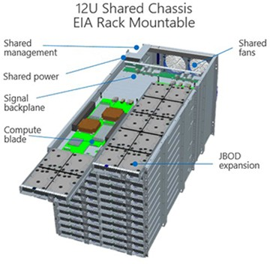
What’s it look like on the inside?
Thousands of rack mounted shared chassis
Operated in the Microsoft Global Foundation Services
Utilizing Open Computer Project Foundation for hardware
http://www.globalfoundati onservices.com/

Slide 13

Where exactly are these Office 365 regions?
North America
South America
EMEA
Japan
APAC
US Government
Australia
India
Canada
In North America:
Quincy, Washington
San Antonio, Texas
Chicago, Illinois
…and other US Data Centers
https://www.microsoft.com/online/legal/v2/?docid=25
14

Slide 14
Can I move my data?
Yes you can…
https://msdn.microsoft.com/en-us/library/dn878163.aspx
New Data Center Regions…
- Japan (12/2014)
- Australia (3/2015)
- India (10/2015)
- Canada (5/2016)
15

Slide 15
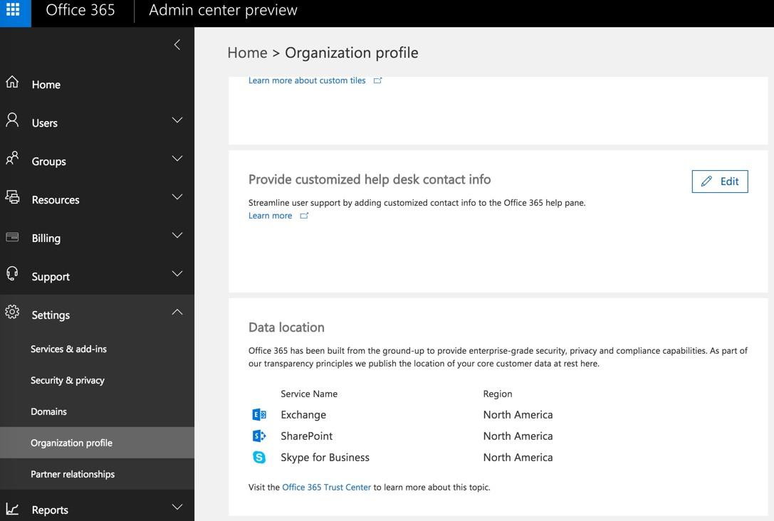
H
ow do I know where my data resides?
17

Slide 16

Service Level Agreement
Office 365 is treated as a component of Microsoft’s online services
5 day prior notification for scheduled maintenance
99.9% Uptime Percentage
Pods and Failover
Service Credits
http://microsoftvolumelicensing.com/DocumentSearch.aspx?Mode=3&DocumentTypeId=37

Slide 18



Setting up a Tenant
What plan do I want?
What will my Tenant Name be?
Who will be my Tenant Administrator? How will users Authenticate?

Slide 19



What’s in a Name?
Where’s a tenant name show up?
User Logons
John.Doe@tenant.onmicrosoft.com* Email Addresses
John.Doe@tenant.onmicrosoft.com*
Private Collaboration Sites
https://tenant.sharepoint.com

Slide 20
Provisioning an Office 365 Tenant
http://go.microsoft.com/fwlink/p/?LinkID=403802

Slide 21
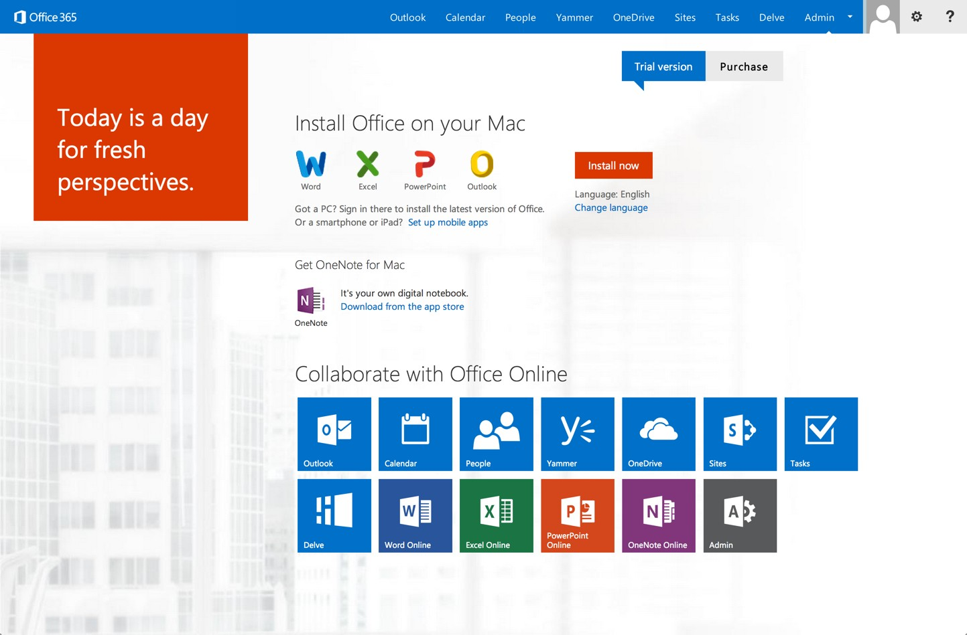
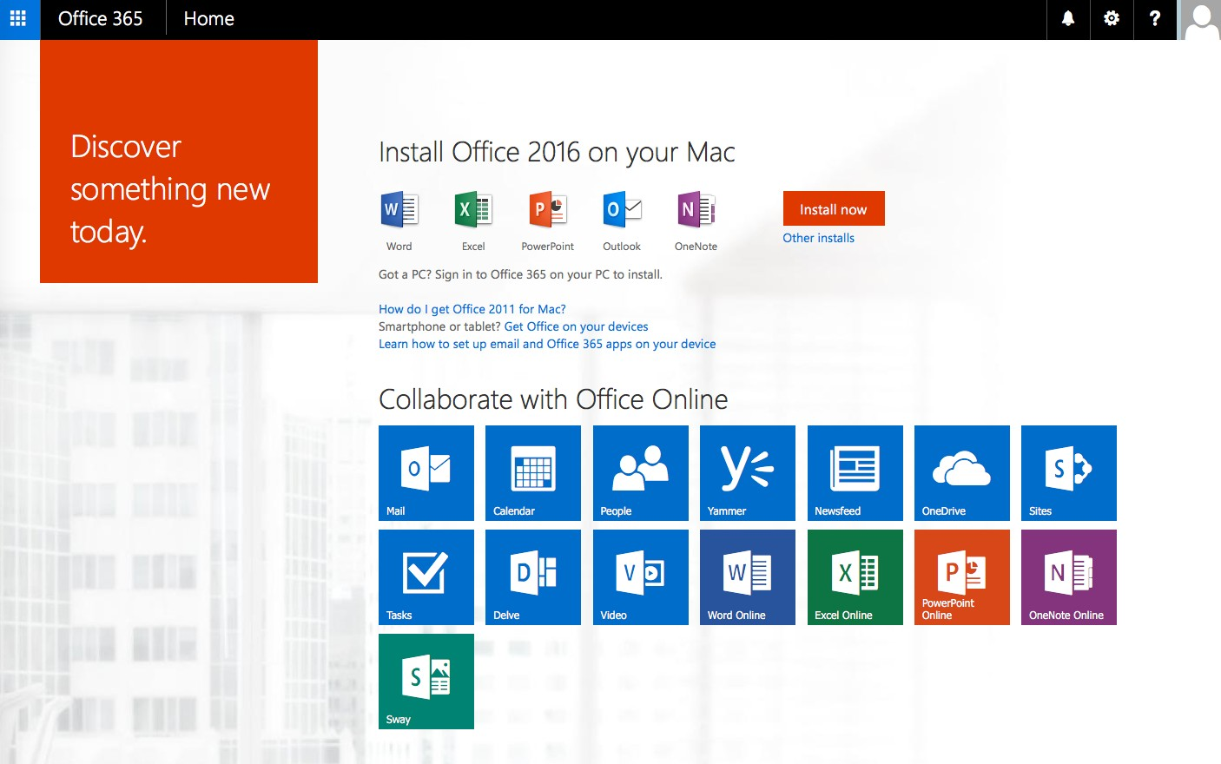

Slide 22
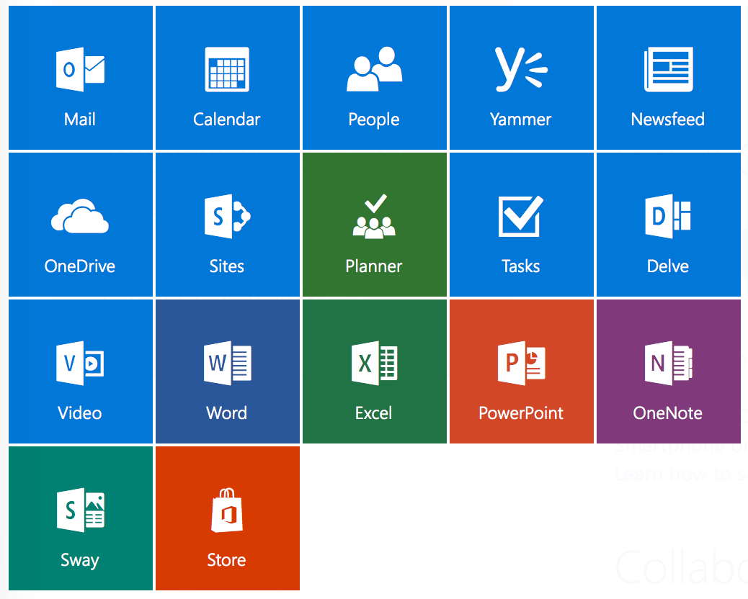


Service
36

Slide 23
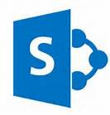
Overview of SharePoint Admin Center
Admin Settings

Slide 24
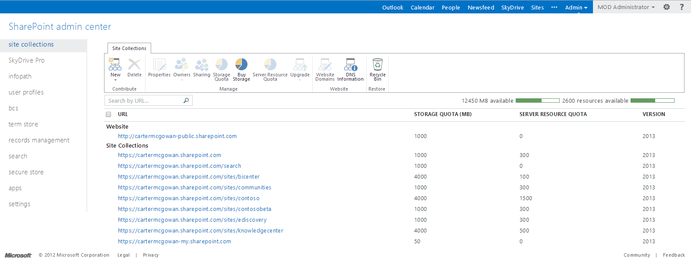
Overview of SharePoint Admin Center
SharePoint Online provides a collection of web-based tools and technologies that help you store, share, and manage digital information within your organization when you use Office 365. This hosted service is ideal for working on projects, storing data and documents in a central location, and sharing information with others. SharePoint sites can help members of your organization work more efficiently and productively.

Slide 25
Overview of SharePoint Admin Center
In the Site Collections section, you can manage your site collections as well as make new one, buy more space, set site collection administrators, and so on.

Slide 26
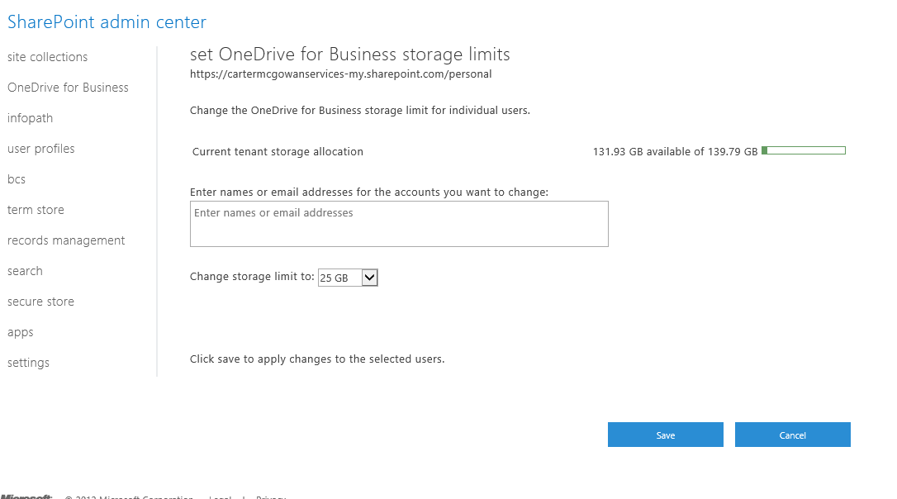
Overview of SharePoint Admin Center
In the One Drive for Business section, you can manage One Drive storage limits.

Slide 27
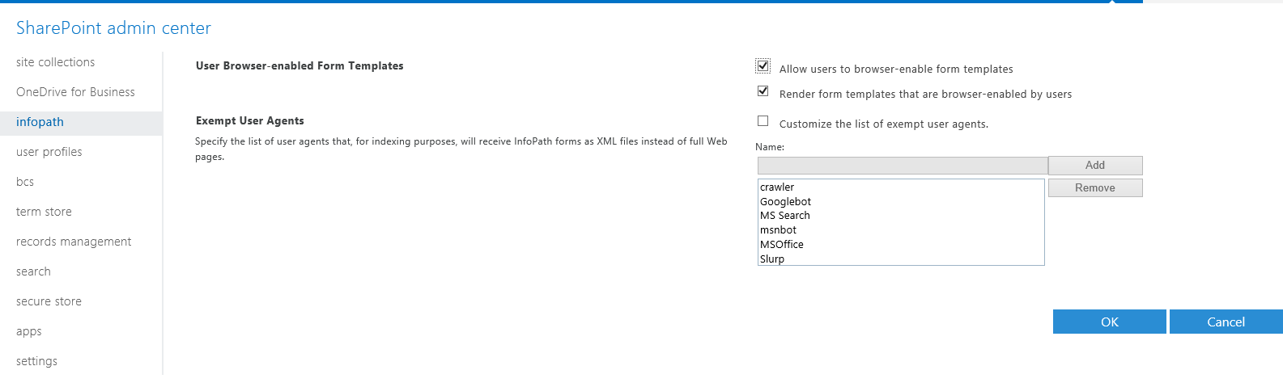
Overview of SharePoint Admin Center
In the InfoPath section, you can manage settings for InfoPath such as allowing the forms to be browser enabled.

Slide 28
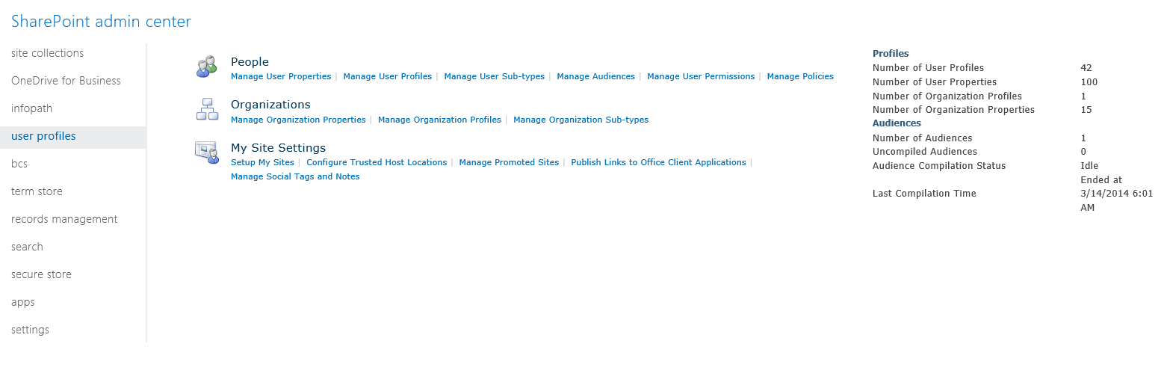
Overview of SharePoint Admin Center
In the User Profiles section, you can manage People, Organization, and My Site settings.

Slide 29
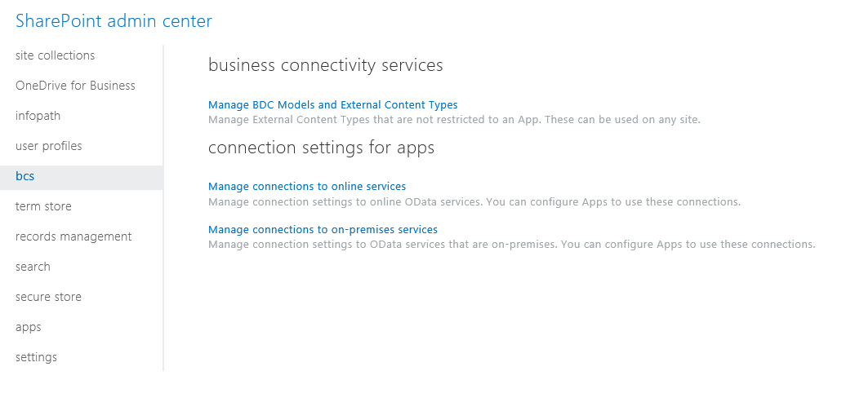
Overview of SharePoint Admin Center
In the BCS section, you can manage BCS and Connection Settings for Apps settings.

Slide 30
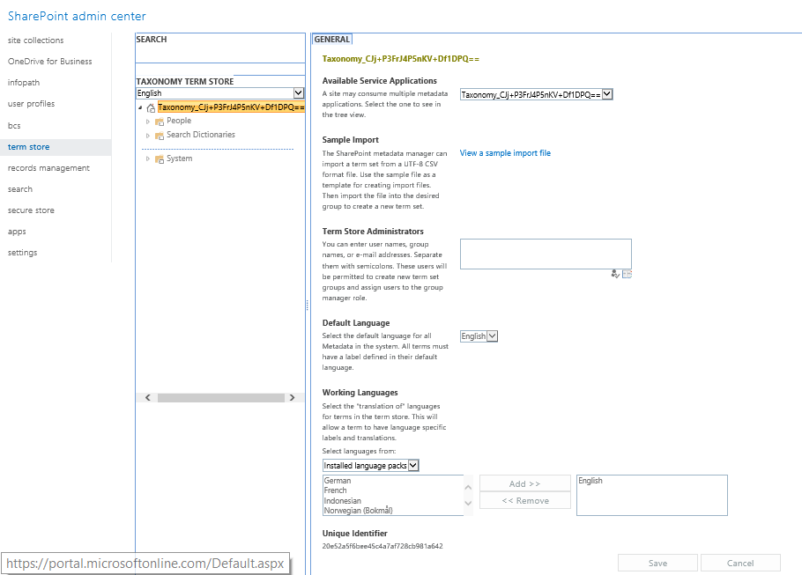
Overview of SharePoint Admin Center
In the Term Store section, you can manage setting such as Term Store Administrators and Working Languages.

Slide 31
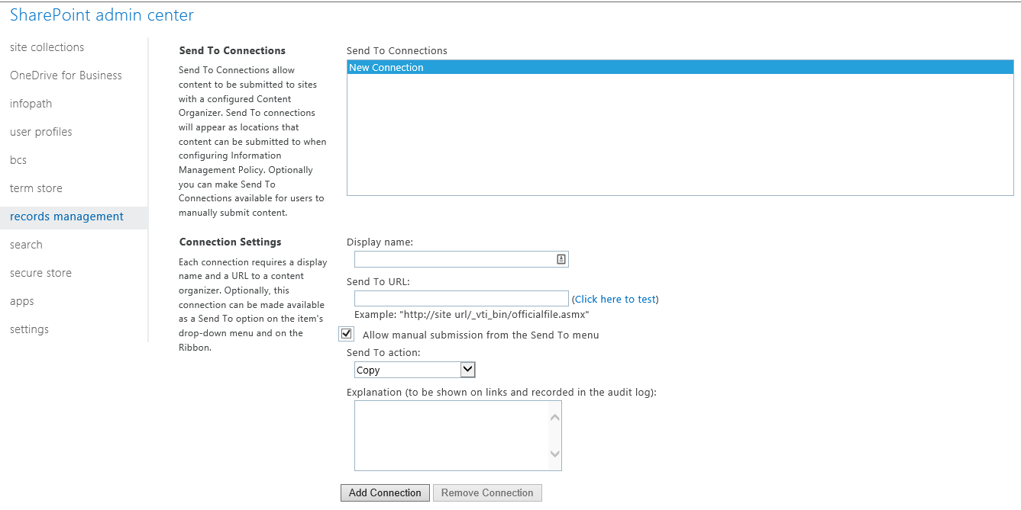
Overview of SharePoint Admin Center
In the Records Management section, you can manage Send to Connections and Connection Settings.

Slide 32
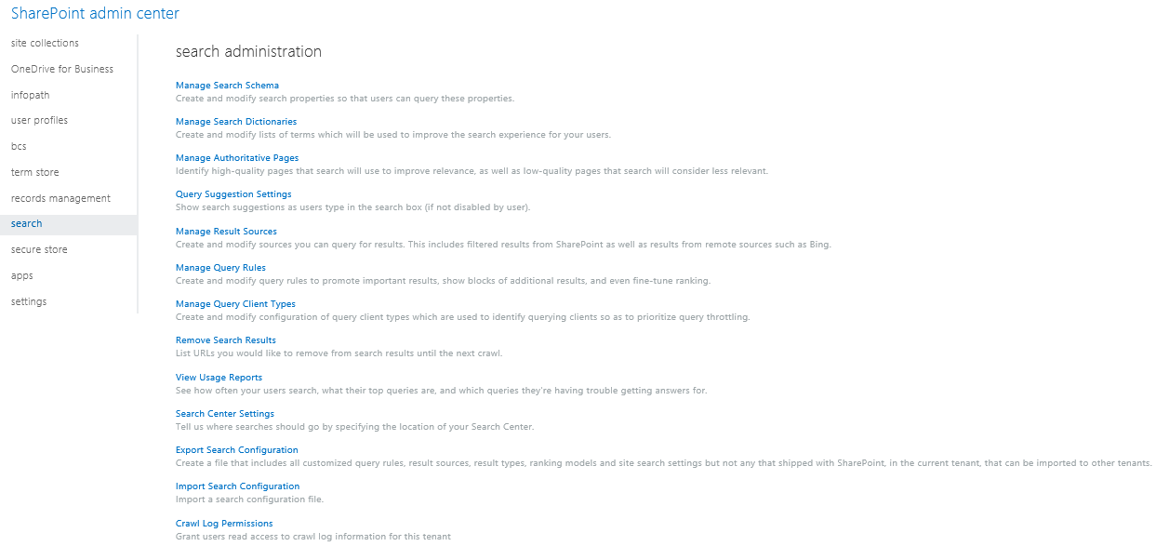
Overview of SharePoint Admin Center
In the Search section, you can administer search settings such as schemas queries, and the crawl log.

Slide 33
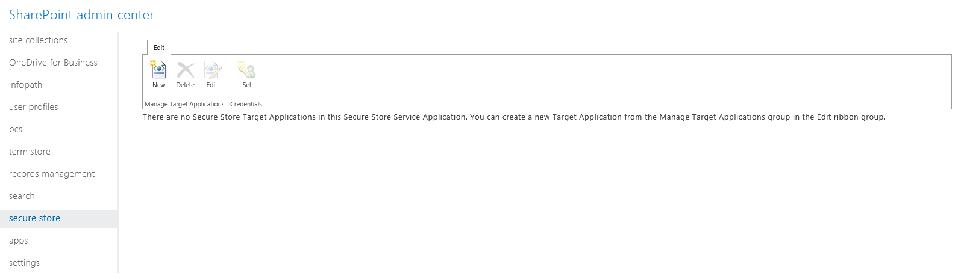
Overview of SharePoint Admin Center
In the Secure Store section, you can manage your secure store target applications.

Slide 34
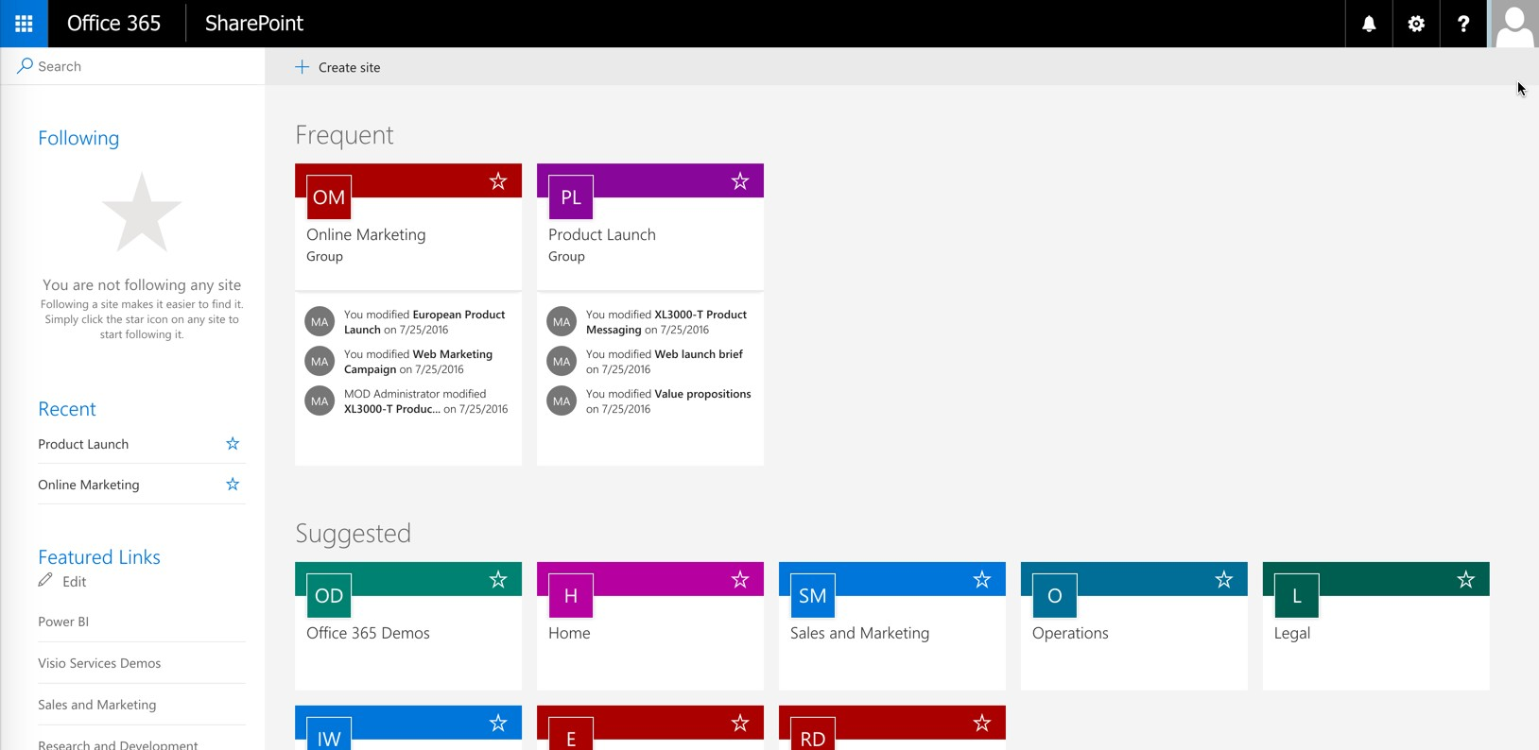
New SharePoint Experience
38

Slide 35
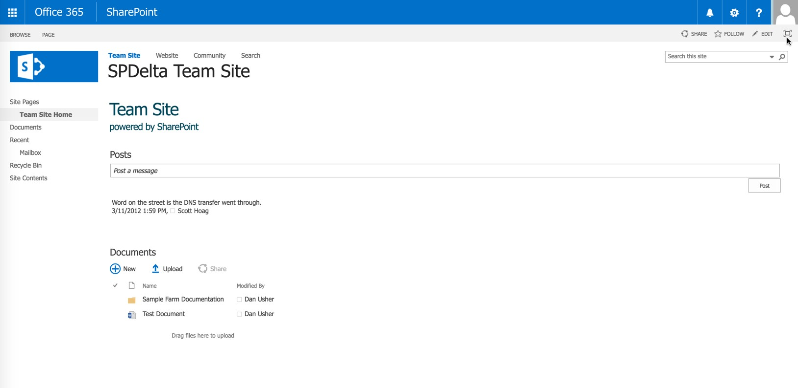
New SharePoint Experience
39

Slide 36
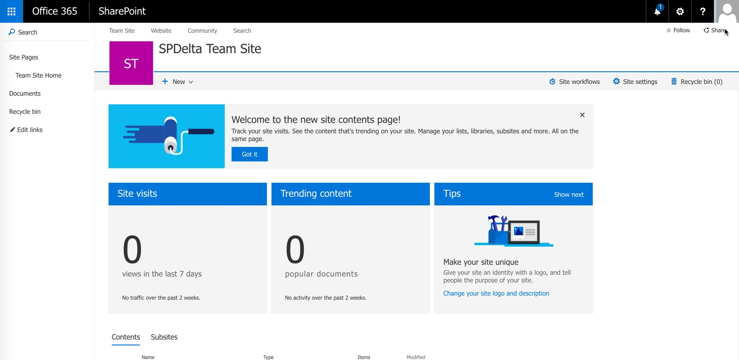
New SharePoint Experience
40

Slide 37
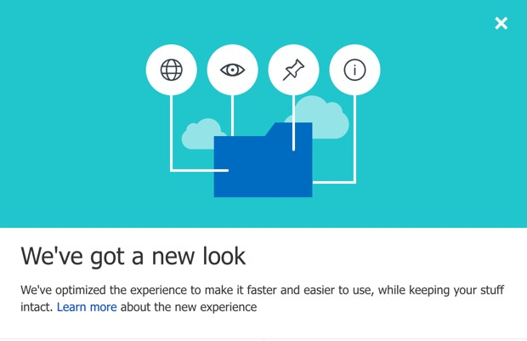
New Document Libraries
41

Slide 38
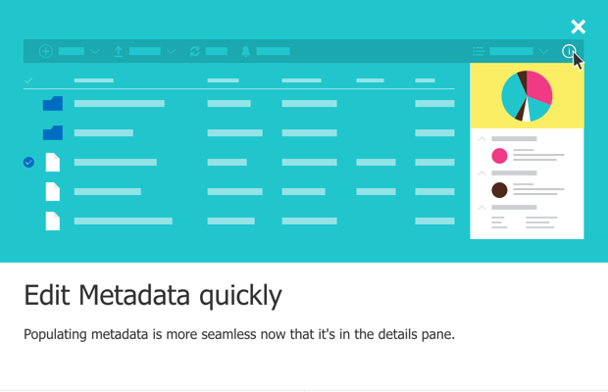
New Document Libraries
42

Slide 39
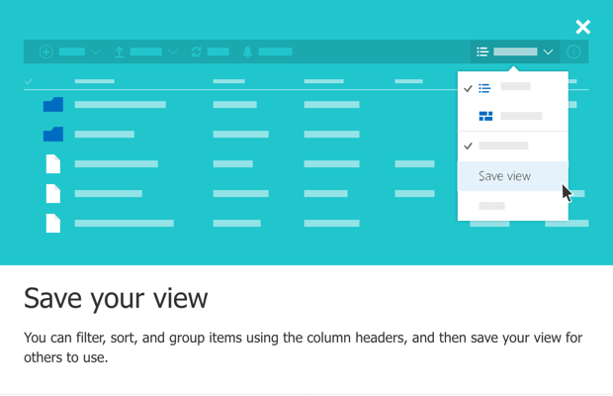
New Document Libraries
43

Slide 40
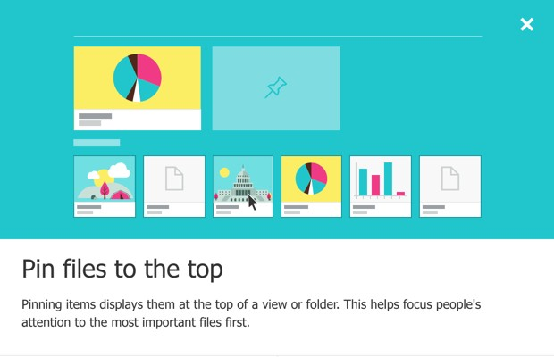
New Document Libraries
44

Slide 41
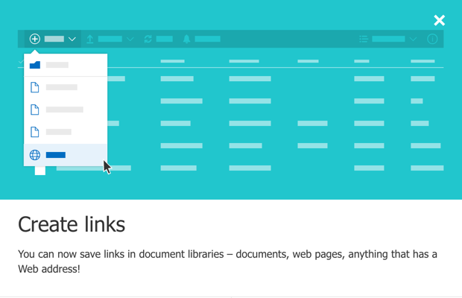
New Document Libraries
45

Slide 42
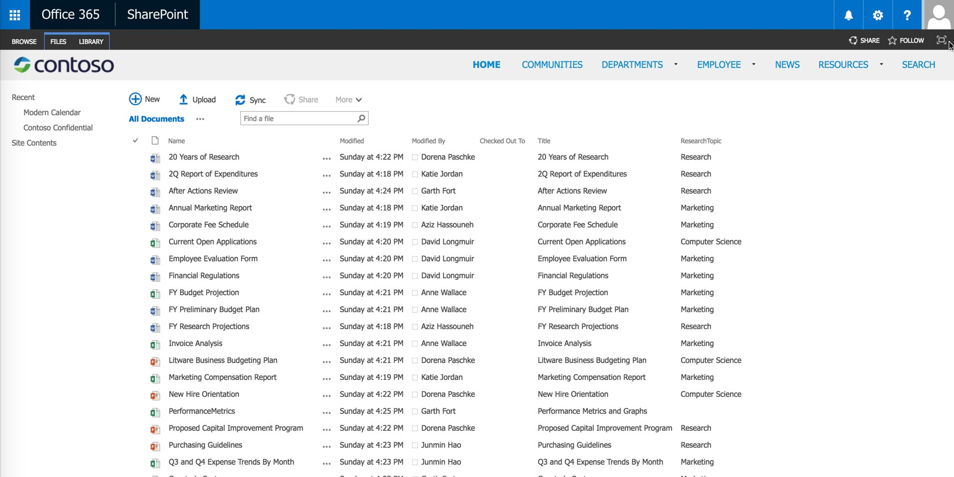
New Document Libraries
46

Slide 43
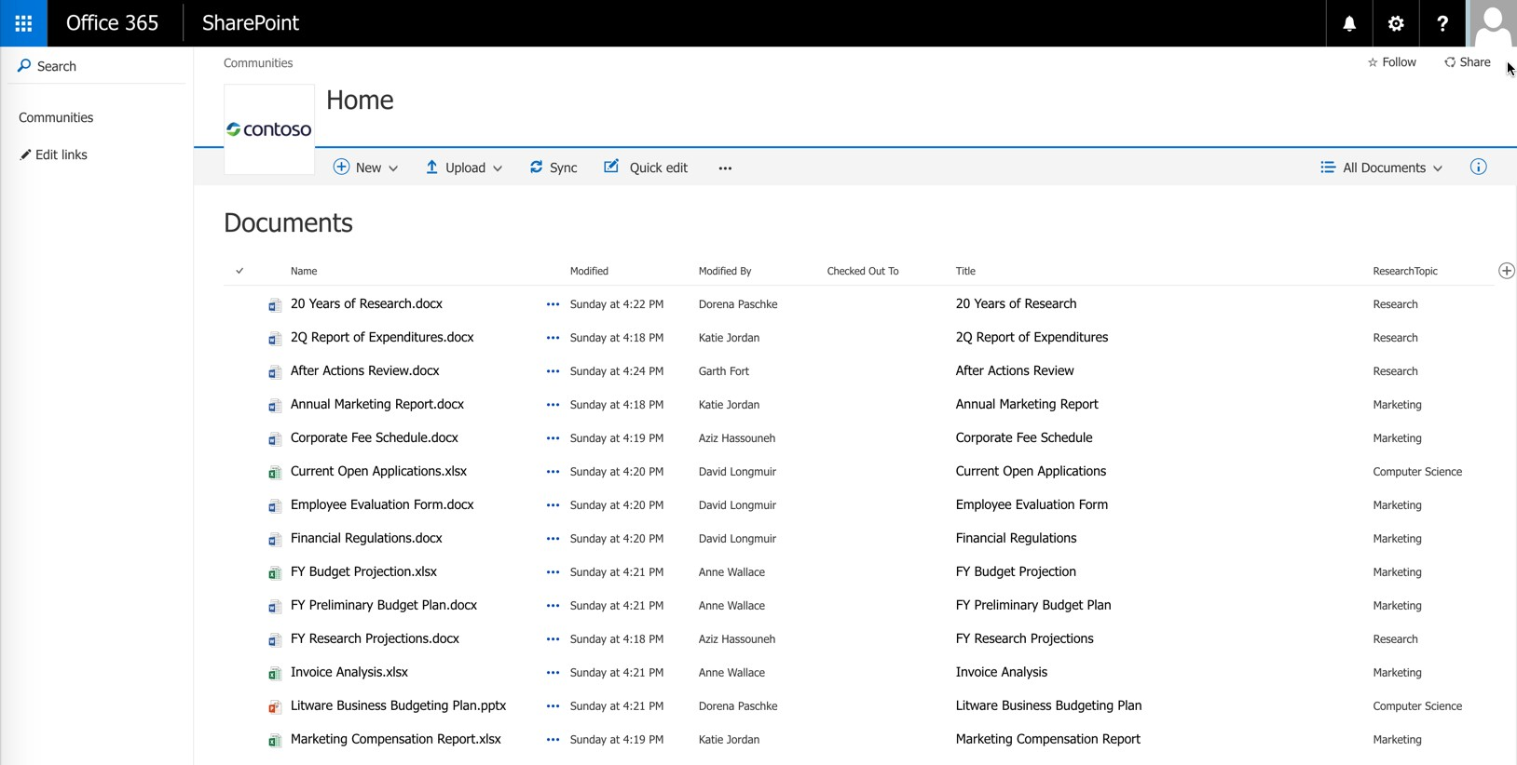
New Document Libraries
47

Slide 44
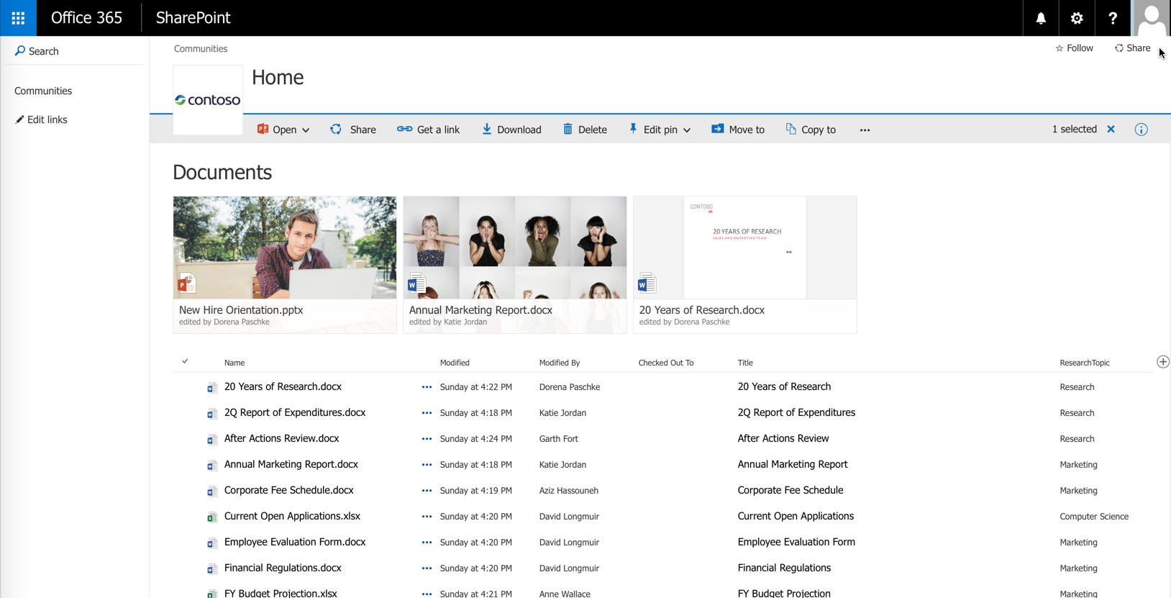
New Document Libraries
48

Slide 45
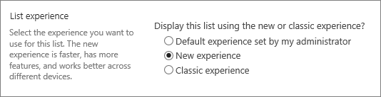
How do I control the experience?
https://support.office.com/en-us/article/Switch-the-default-for-document- libraries-from-new-or-classic-66dac24b-4177-4775-bf50-3d267318caa9
Single Document Library (Library Owners)
All Document Libraries (Administrators)
Site and Site Collection Level Document Libraries using PowerShell (Administrators)
49

Slide 46
Where’s my cheese?
Things change…
Do you remember your reaction when you opened up SharePoint 2013?
User Interfaces changing and becoming more responsive to your device…
Admin Center changed
OneDrive and Document Libraries
Lists
50

Slide 47
Authentication

Slide 48

Authentication Options in The Cloud™
Cloud Identity
Directory and Password Synchronization Federation

Slide 49

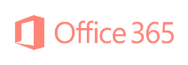





Identity Scenarios
Federated Identity
Single federated identity and credentials
Cloud Identity
Directory & Password Synchronization
Single identity in the cloud with no integration to on-premises directories
Single identity and credentials

Slide 50



Planning for Office 365
Office 365 Service Description
http://www.office365sd.com
Office 365 Deployment Guide
http://technet.microsoft.com/en-us/library/hh852466.aspx

Slide 51








More Planning for Office 365
Deployment Readiness Tool
https://onramp.office365.com/onramp/
SharePoint Online Filterable Comparison
http://technet.microsoft.com/en-us/office365/fp123607

Slide 52


The Human Side
Trust Center
https://trust.office365.com
Change Management Plans
http://technet.microsoft.com/en-us/office365/dn342872.aspx
Training Center
http://office.microsoft.com/en-us/office-365-for-business-learning-center-FX102821134.aspx

Slide 53
Certifications
Learning Paths
https://mspartnerlp.mspartner.microsoft.com/LearningPath
Certification - Office 365 MCSA
http://www.microsoft.com/learning/en-us/mcsa-office365-certification.aspx
Managing Office 365 Identities and Requirements (70-346) Enabling Office 365 Services (70-347)

Slide 54









SKU Overview and Licensing

Slide 55










SKU Overview and Licensing

Slide 56
Office 365 Admin Panel and User Management
Demo

Slide 57
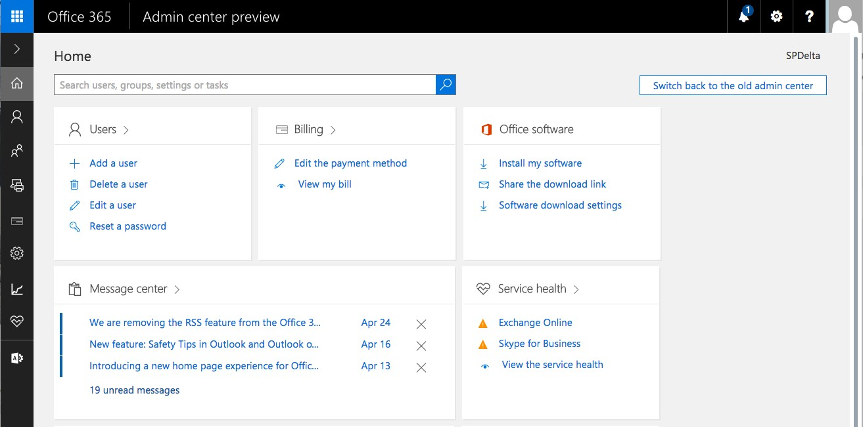
Office 365’s Admin Portal

Slide 58
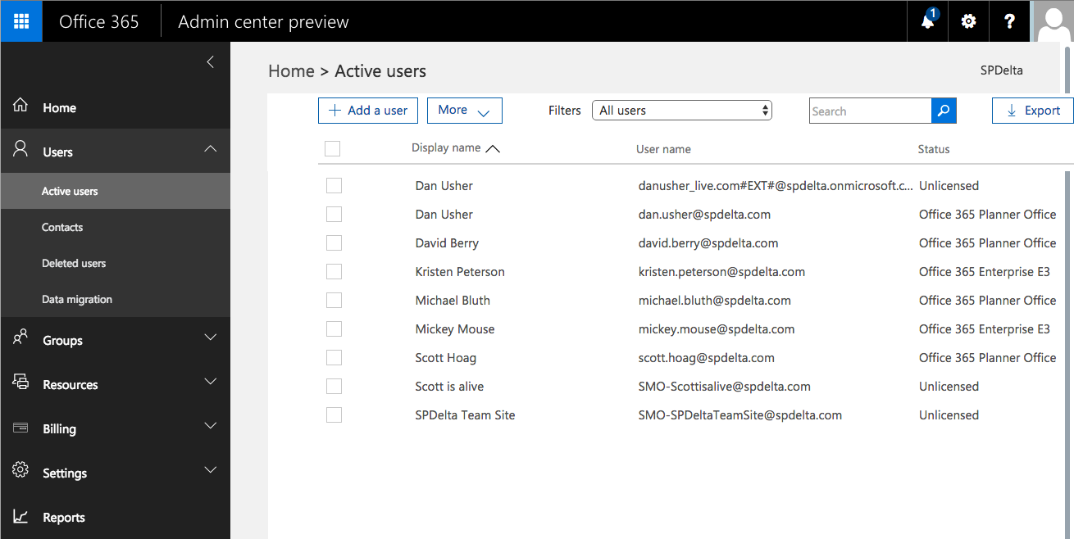
User Management – Cloud Identities
65

Slide 59
What about OneDrive…

Slide 60





What’s this OneDrive for Business thing?
It’s not OneDrive through Live Services!
- Or is it?
My Sites
Personal Site Collection
Office 365 provides for 1 TB per user document
OneDrive for Business Windows Sync Client
MySite
Host
library*
OneDrive for Business document library
Backstage
- Fewer file type restrictions that other document
libraries
Allows for sharing like any other document library
Installs with Office 365 ProPlus / 2013 / 2016 applications
Can be installed with OneDrive for Business Client
Can be installed through OneDrive app
Windows (File) Explorer
(Favorites)
OneDrive
SharePoint OneDrive @ SPDelta
OneDrive for Business
Team Sites
Synchronizes files with OneDrive for Business every 10 minutes
Doesn’t replace SharePoint Workspaces
Document
Libraries

Slide 61
OneDrive for Business against the competition…
Others are hosted on other platforms that are more about document storage whereas Microsoft is going for a platform.
OneDrive for Business is SharePoint Based
Provides for encryption and document management
Points of Integration:
Profiles
Office Applications
Yammer
Delve
Groups
End to end Experience - http://go.spdan.com/endtoend

Slide 62
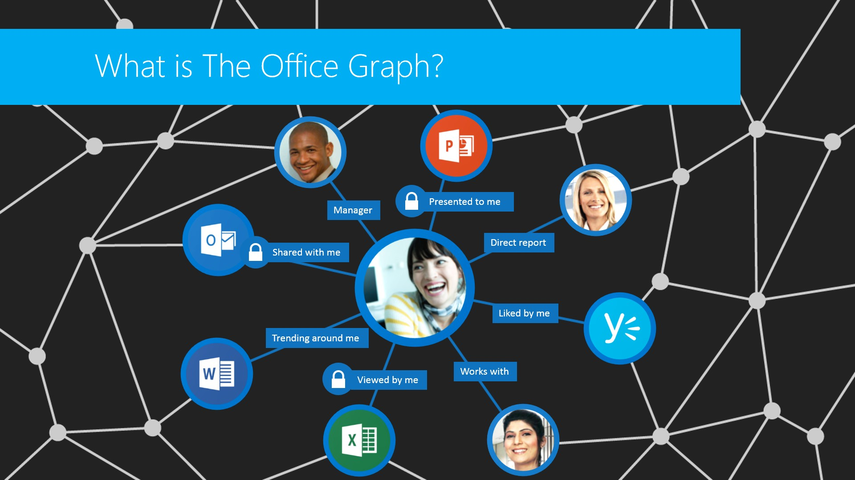
Office Graph

Slide 63
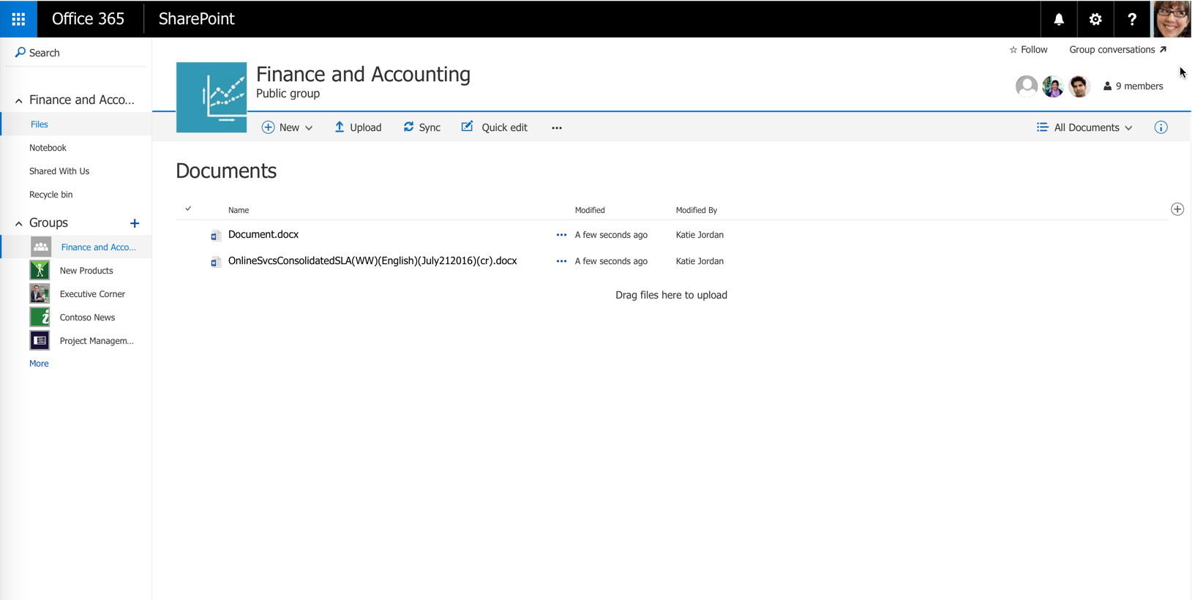
Documents
79

Slide 64
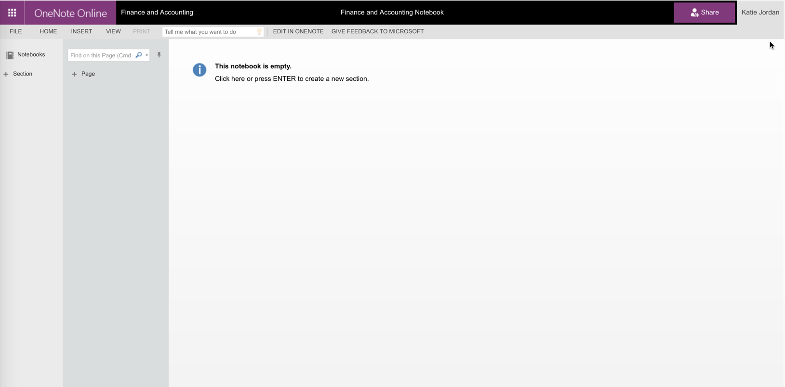
OneNote Notebook
80

Slide 65
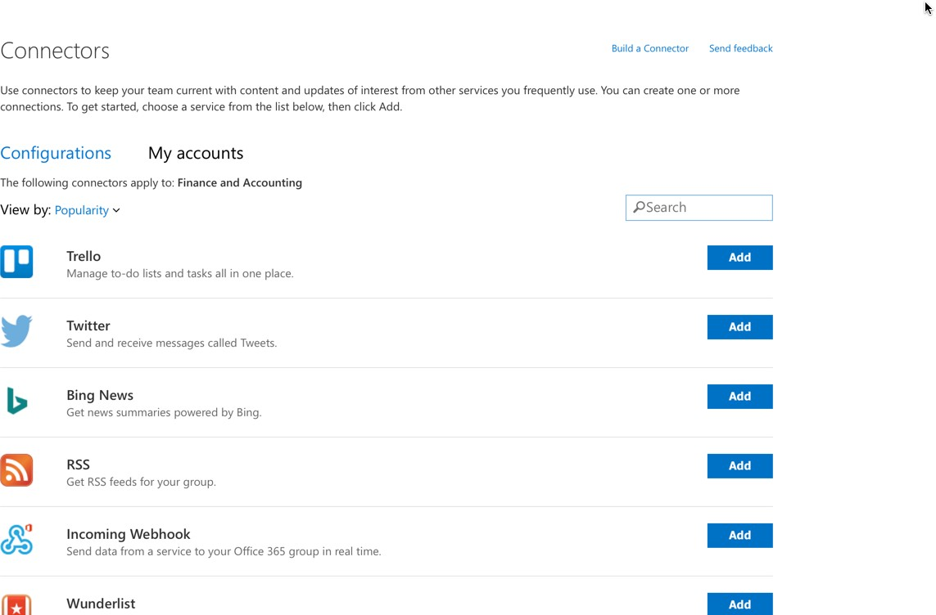
Connectors
81

Slide 66
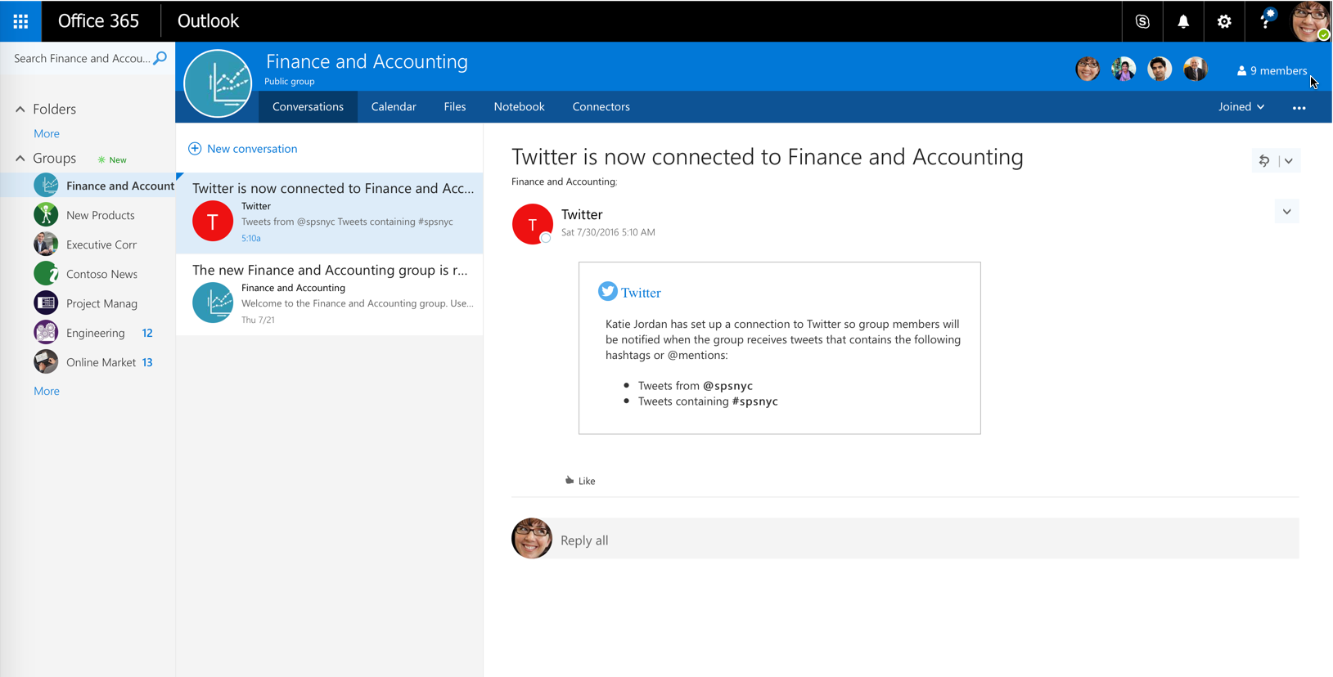
Conversations
82

Slide 67
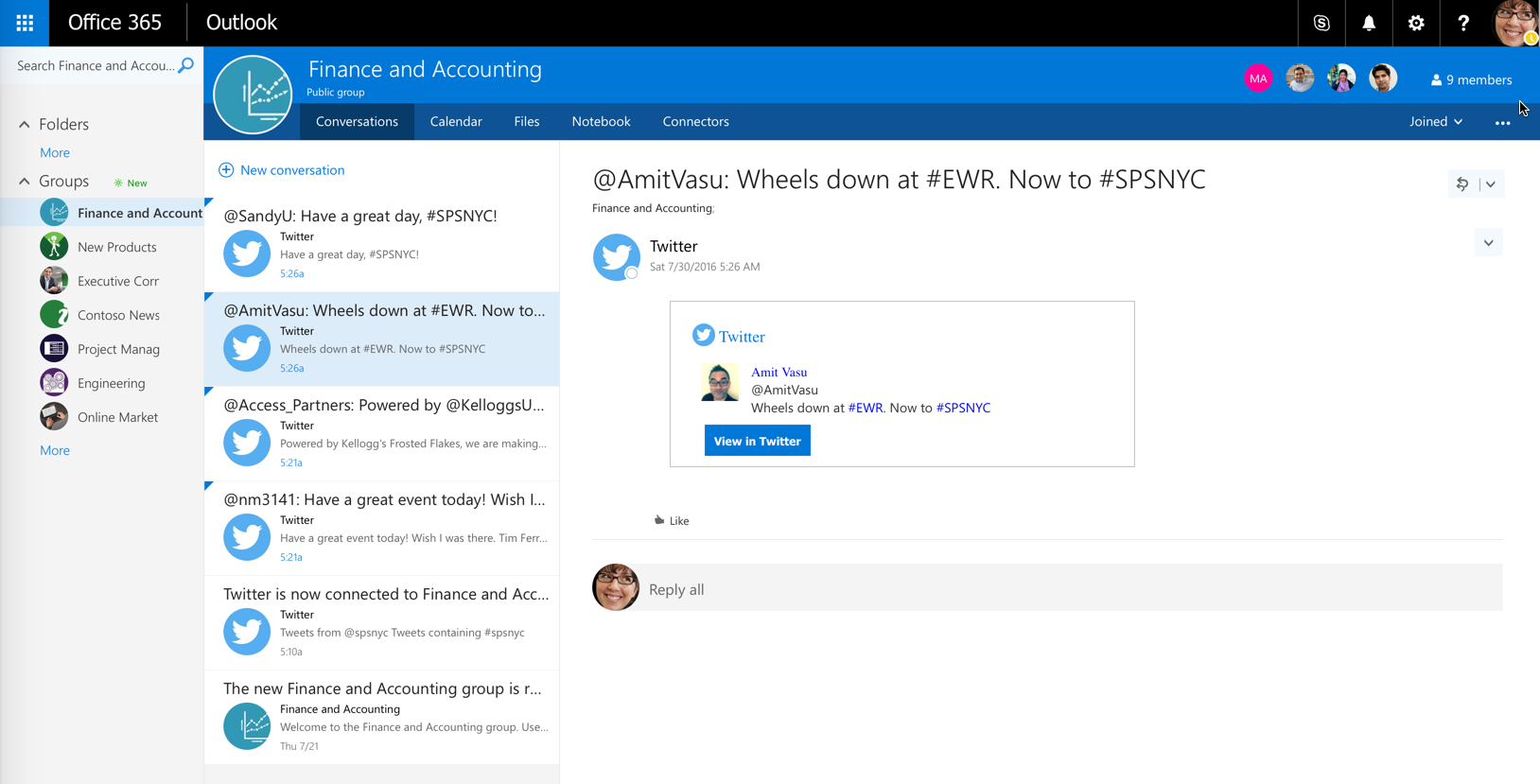
Conversations and Twitter
83

Slide 68
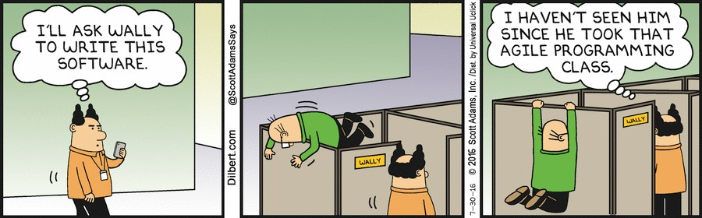
Developer Story
84

Slide 69

App Types – Provider Hosted
Cloud
SharePoint
Provider-hosted
Existing sites and services
REST + OAuth or client object models
app web (optional)
Dedicated server / hosting service
ISV or IT organization provides the hosting infrastructure ISV / IT is responsible for tenant isolation
Allows for greatest flexibility, requires greatest responsibility Can use site elements, lists, files, web parts

Slide 70
App Types – SharePoint Hosted
SharePoint
SharePoint-hosted
Existing sites and services
app web
Can use site elements, lists, files web parts Can use HTML and JavaScript
Isolation is contained through app web provisioning

Slide 71
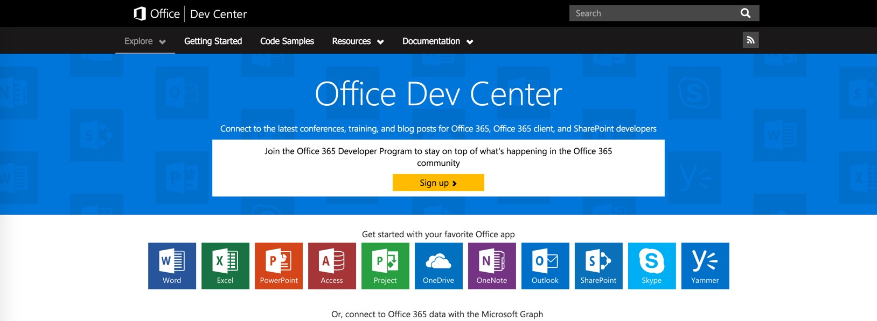
Resources for Developers
Tools, Training and Documentation to get started - http://Dev.office.com

Slide 72
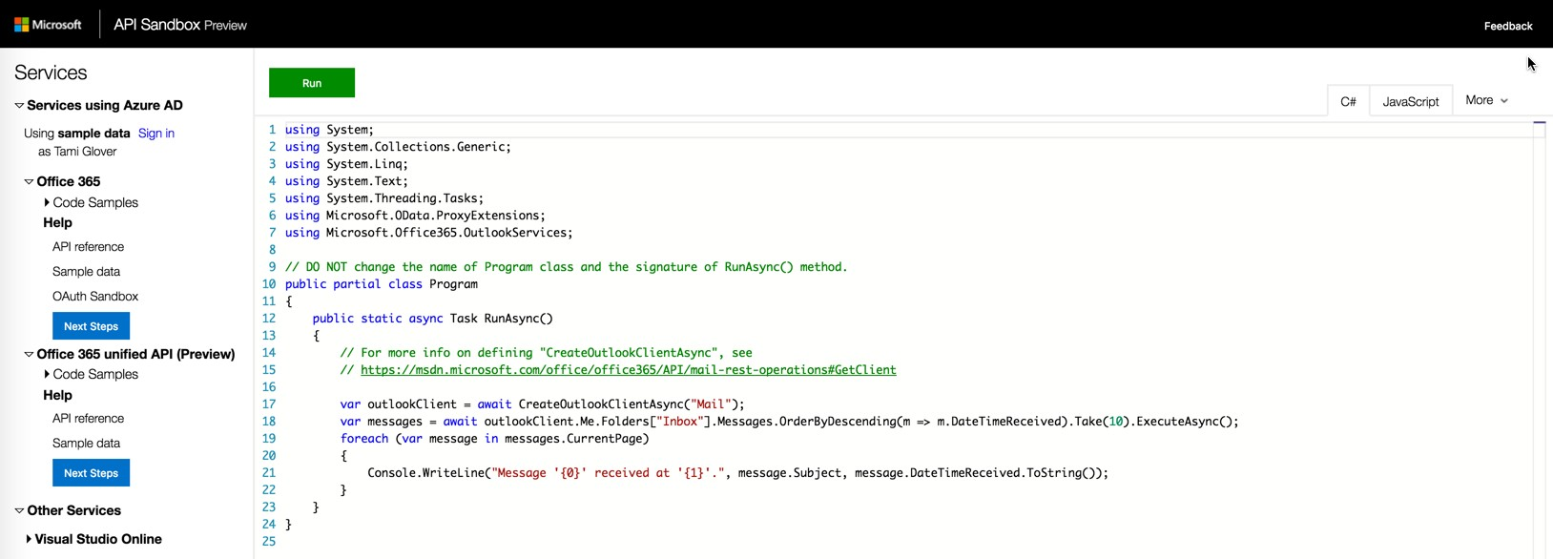
Resources for Developers
MSDN Office Developer API Sandbox http://apisandbox.msdn.Microsoft.com

Slide 73
Office 365 - Gotchas
Adding an app
Requires a Live Account (Microsoft Account)
Sharing with an external user
Follow the token
What version are you running?
https://<your tenant>.sharepoint.com/_vti_pvt/buildversion.cnf
How do you test production versus a test tenant?
Chris O’Brien - http://www.sharepointnutsandbolts.com/2014/03/Office-365-first- release-and-nda-preview.html

Slide 74
Office 365 - Gotchas
Patches
http://blogs.technet.com/b/office_sustained_engineering/
Azure Active Directory - Directory Synchronization
Be sure to remediate issues prior to synchronization with IdFix
Azure Active Directory - Office 365 Software Entitlements
If provisioned through Azure, will have to add entitlements through PowerShell or WebUI

